Slide 1
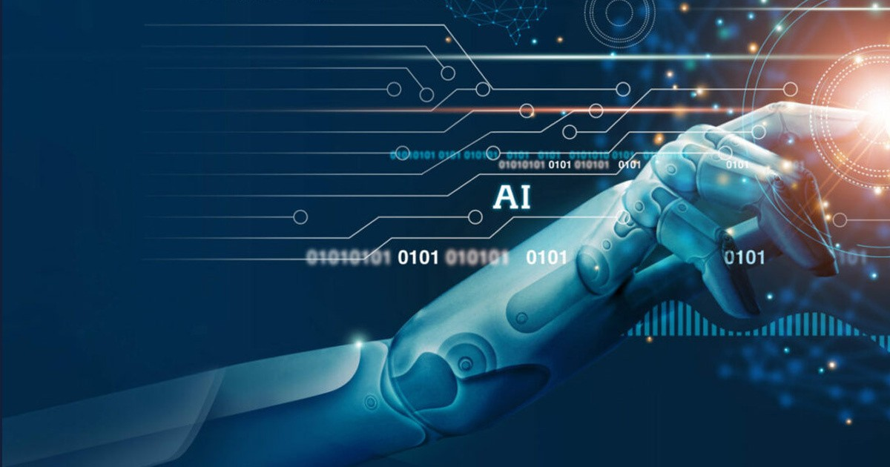
AI Powered Re-Engineering
Presented by: Aisha Umer
(20p-0479)

Slide 2
Introduction
Utilizing artificial intelligence (AI) and machine learning (ML) methods to improve, automate, and optimize different stages of the software development lifecycle.
Aimed at overcoming the limitations of conventional software re-engineering approaches.

Slide 3
Re-Engineering in SDLC
By revisiting and revitalizing existing software systems, organizations can achieve several key objectives:
Efficiency
Quality
Scalability

Slide 4
Challenges in Traditional Re-Engineering
Manual Code Review Processes
Lack of Scalability
Time-Consuming Analysis

Slide 5


Slide 6
Static Code Analysis
Examining source code without executing it.
SonarQube is used for static code analysis, to detect bugs, vulnerabilities, and code smells in codebases.

Slide 7
sonarQube
SonarQube is an open-source platform for continuous inspection and analysis of code quality, aiding developers, teams, and organizations in maintaining high standards of code quality.
It supports a wide range of programming languages, making it suitable for diverse software development projects.
Suggested code improvements, to streamline the re-engineering process.

Slide 8
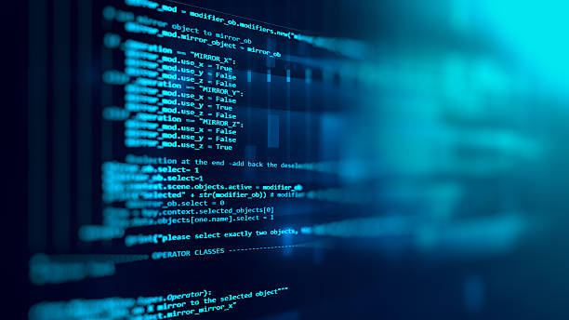
Demo

Slide 9
Thankyou

